Slide 1
Camera Model & Calibration

Slide 2
What is camera calibration?
Geometric camera calibration, also referred to as camera resectioning, estimates the parameters of a lens and image sensor of an image or video camera. You can use these parameters to correct for lens distortion, measure the size of an object in world units, or determine the location of the camera in the scene. These tasks are used in applications such as machine vision to detect and measure objects. They are also used in robotics, for navigation systems, and 3-D scene reconstruction.

Slide 3
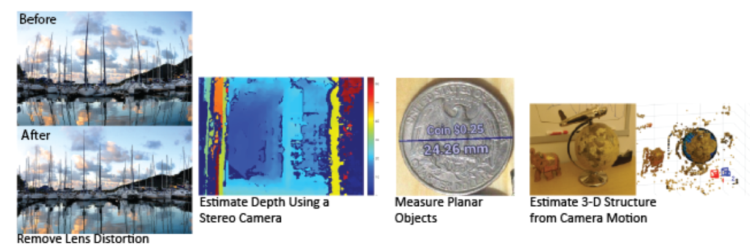
Examples of what you can do after calibrating your camera

Slide 4
Camera Calibration
To determine extrinsic and intrinsic parameters of camera
Extrinsic
3D location and orientation of camera
Intrinsic
Focal Length
The size of the pixel

Slide 5
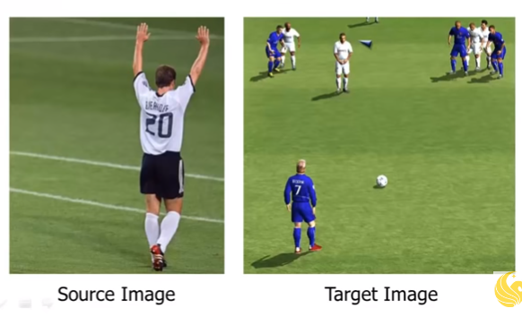
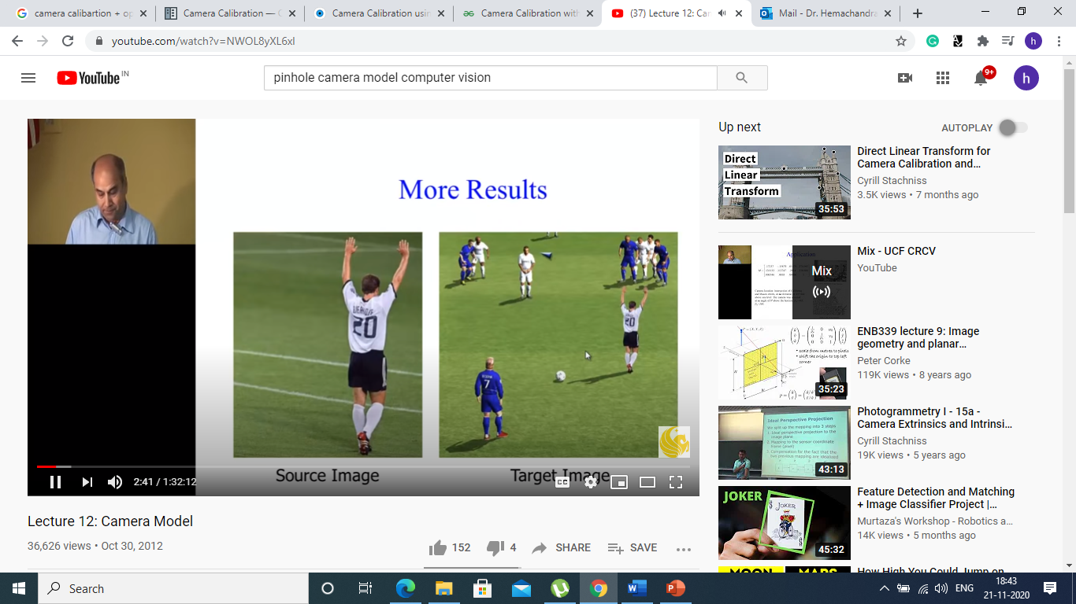
Application : Object Transfer

Slide 6
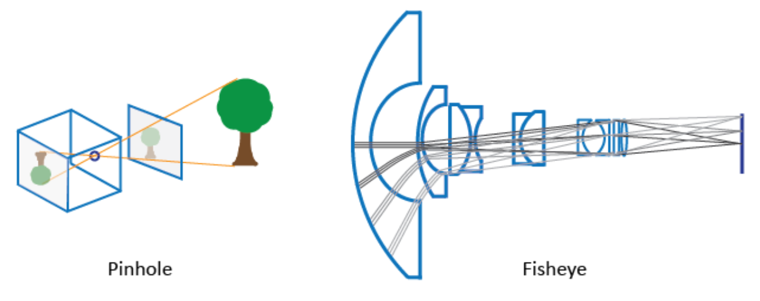
Camera Models
Pinhole Camera Model
Fisheye Camera Model

Slide 7
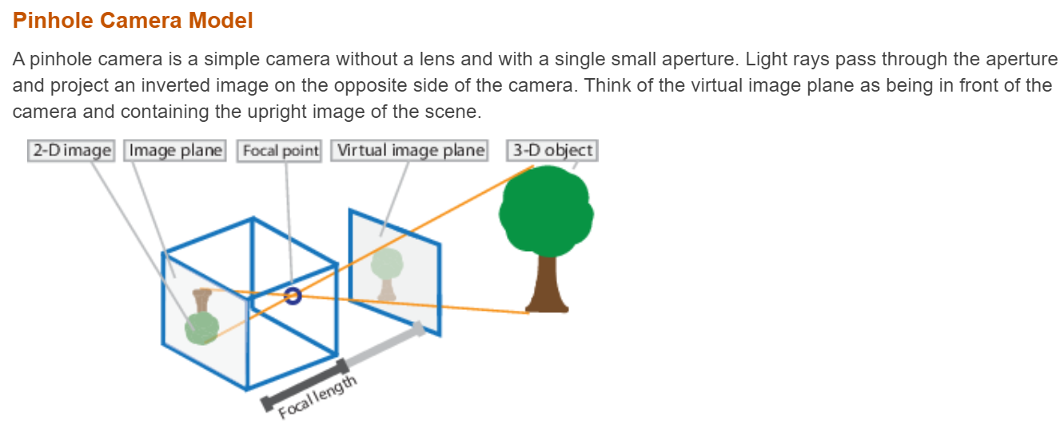

Slide 8
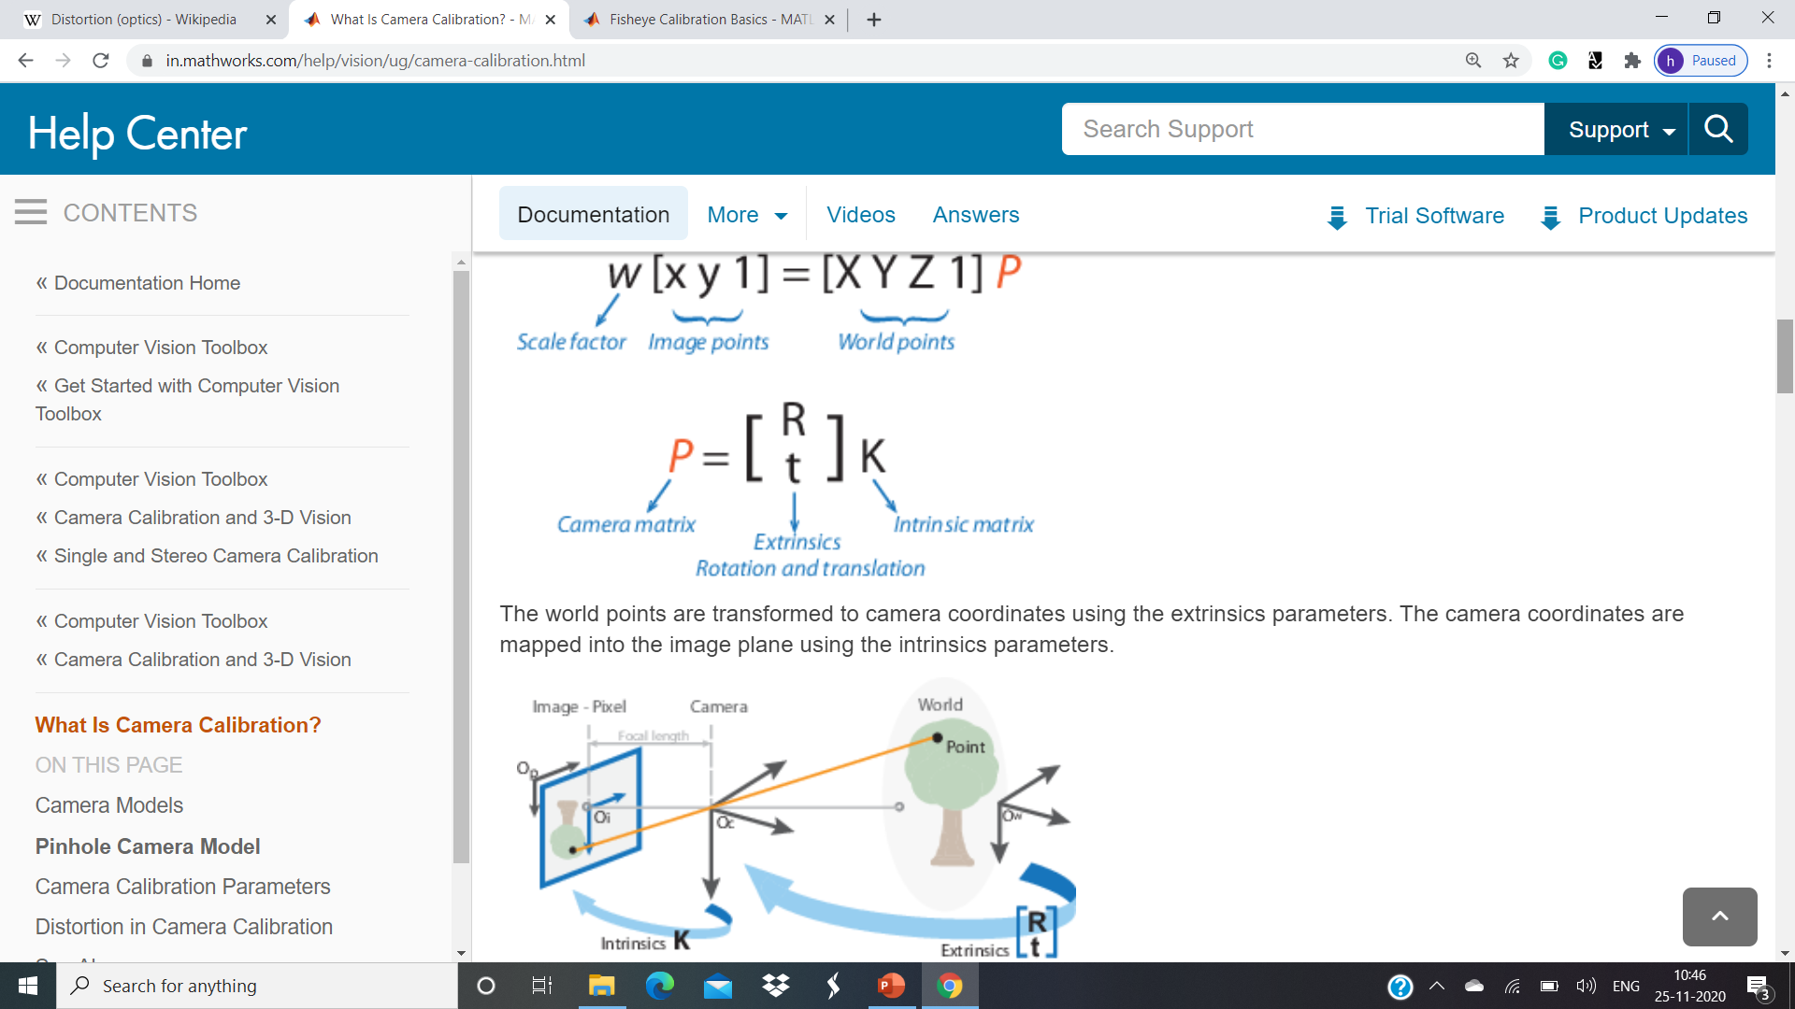
W [X Y 1] = [X Y Z 1] P

Slide 9
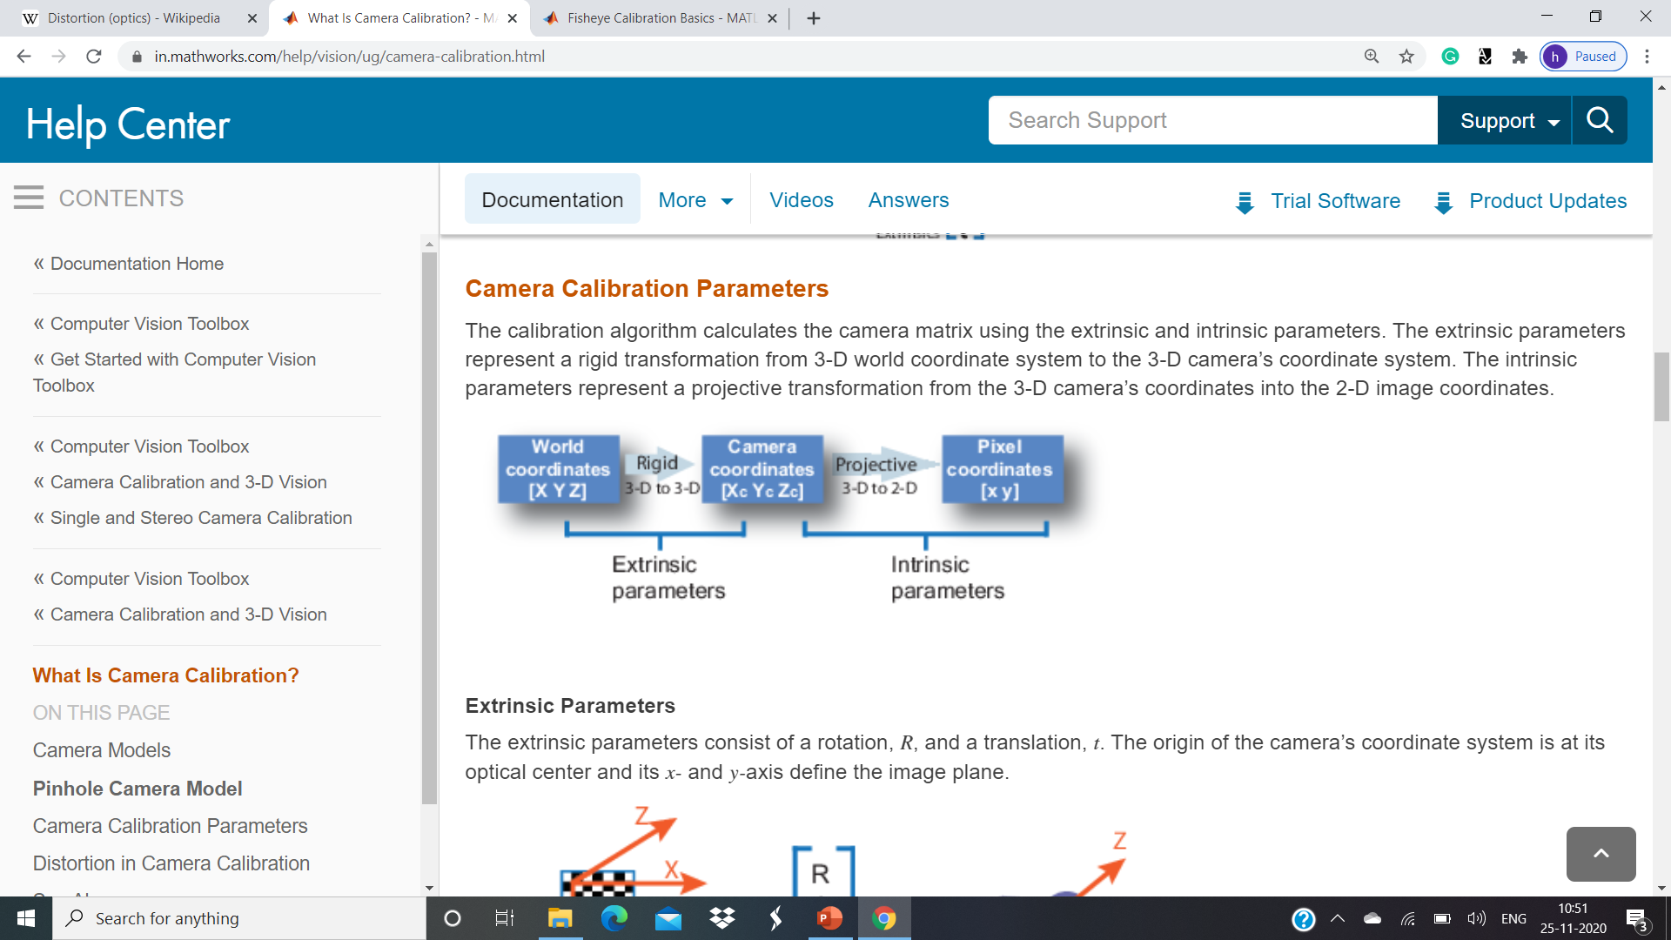

Slide 10
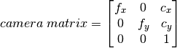
Camera Matrix
Intrinsic parameters are specific to a camera.
Focal length (fx ,fy)
Optical centers (cx, cy)
fx=F/px fy=F/py F — Focal length in world units, typically expressed in millimeters. (px,py) — Size of the pixel in world units.

Slide 11
Fisheye Calibration
Camera calibration is the process of computing the extrinsic and intrinsic parameters of a camera. Once you calibrate a camera, you can use the image information to recover 3-D information from 2-D images. You can also undistort images taken with a fisheye camera.
Fisheye cameras are used in odometry and to solve the simultaneous localization and mapping (SLAM) problems visually. Other applications include, surveillance systems, GoPro, virtual reality (VR) to capture 360 degree field of view (fov), and stitching algorithms. These cameras use a complex series of lenses to enlarge the camera's field of view, enabling it to capture wide panoramic or hemispherical images. However, the lenses achieve this extremely wide angle view by distorting the lines of perspective in the images

Slide 12
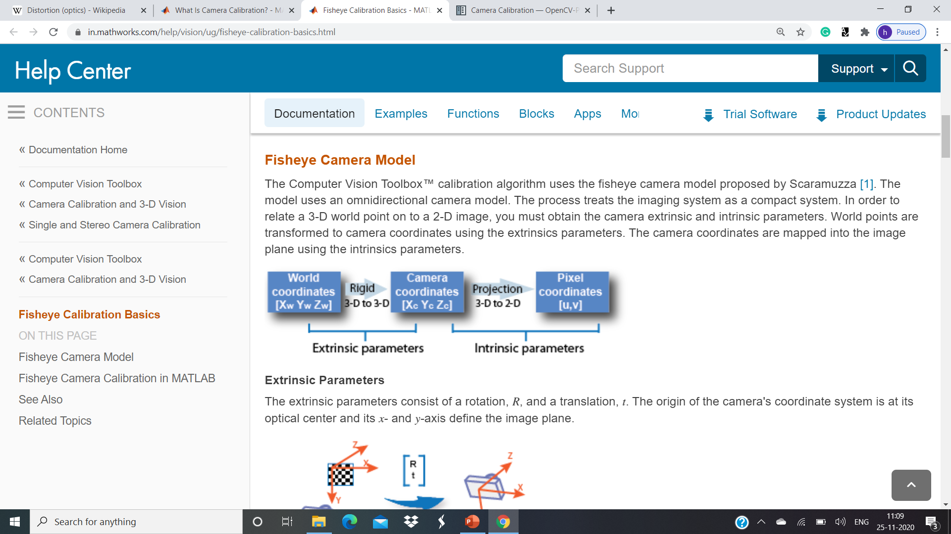

Slide 13
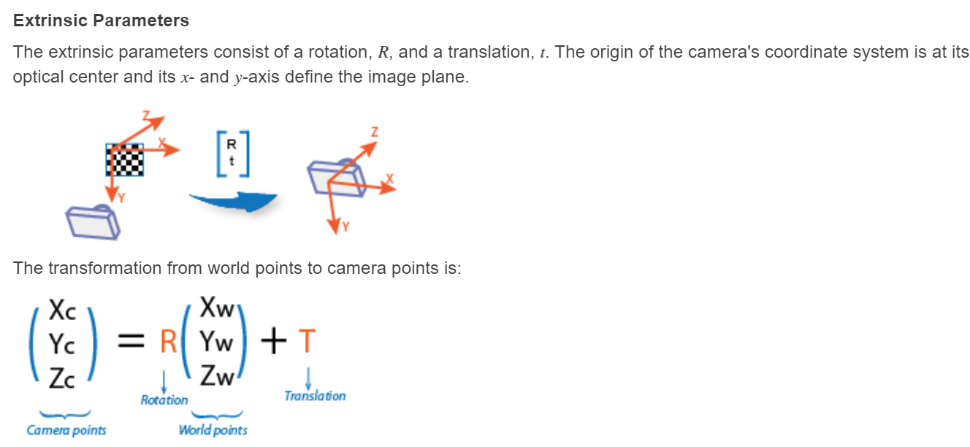

Slide 14
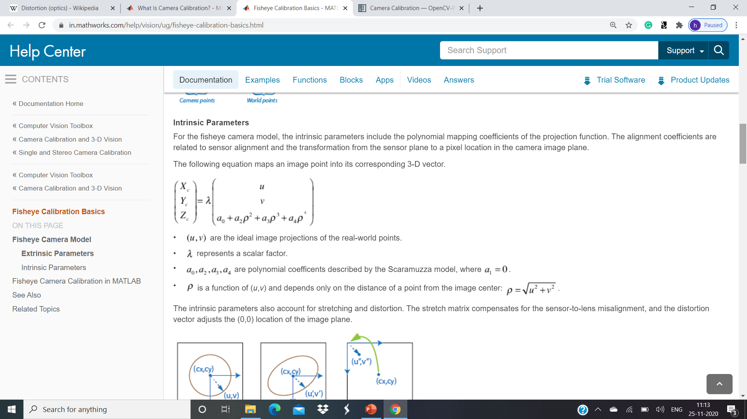

Slide 15
Pose estimation
Given 3D model of object, and its image (2D projection) determine the location and orientation (translation & rotation) of object such that when projected on the image plane it will match with the image.
https://www.youtube.com/watch?v=ZNHRH00UMvk

Slide 16

3D Translation
T = $\left[\begin{matrix}1 & 0 & 0 & dx \\ 0 & 1 & 0 & dy \\ 0 & 0 & 1 & dz \\ 0 & 0 & 0 & 1\end{matrix}\right]$ T⁻¹= $\left[\begin{matrix}1 & 0 & 0 & −dx \\ 0 & 1 & 0 & −dy \\ 0 & 0 & 1 & −dz \\ 0 & 0 & 0 & 1\end{matrix}\right]$
T T⁻¹ = I

Slide 17

Scaling
S = $\left[\begin{matrix}Sx & 0 & 0 & 0 \\ 0 & Sy & 0 & 0 \\ 0 & 0 & Sz & 0 \\ 0 & 0 & 0 & 1\end{matrix}\right]$ S⁻¹= $\left[\begin{matrix}1/Sx & 0 & 0 & 0 \\ 0 & 1/Sy & 0 & 0 \\ 0 & 0 & 1/sz & 0 \\ 0 & 0 & 0 & 1\end{matrix}\right]$
S S⁻¹ = I

Slide 18
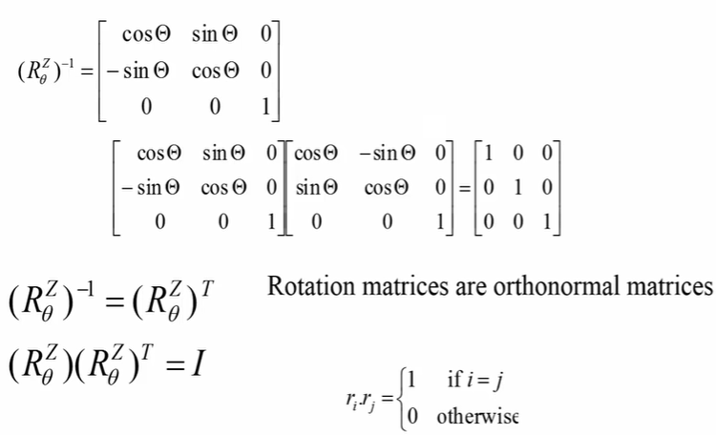
3D - Rotation

Slide 19
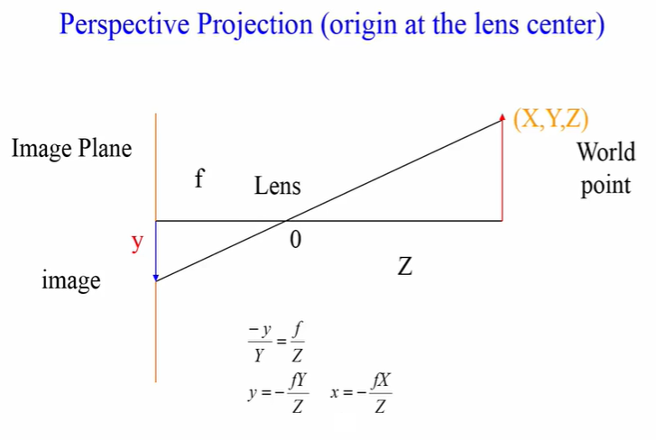

Slide 20
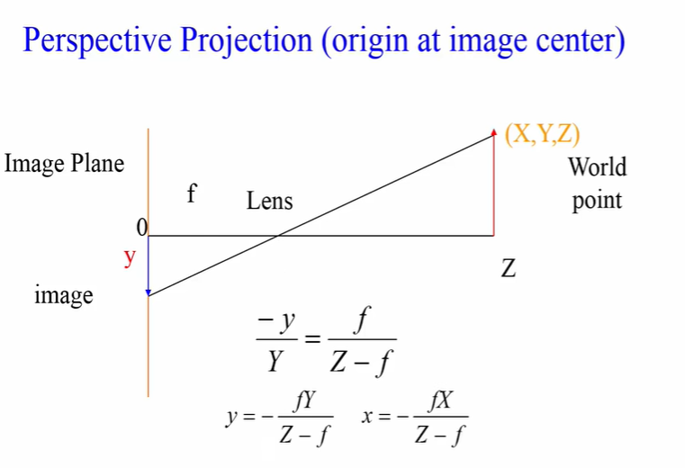

Slide 21
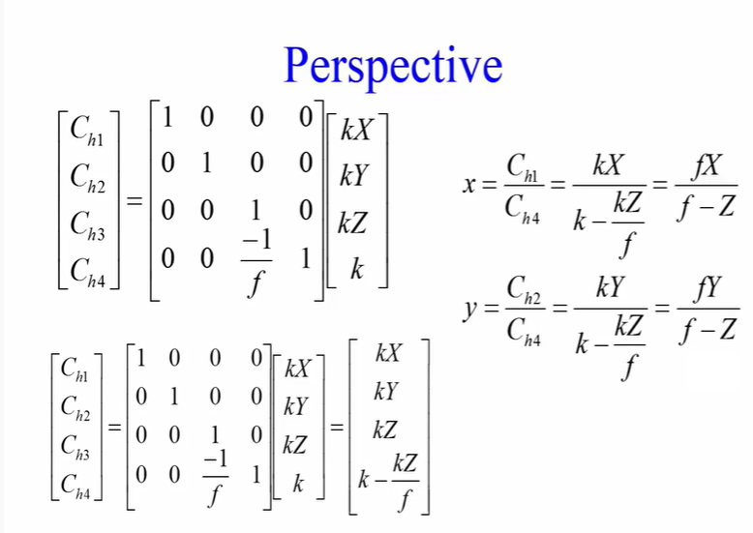

Slide 22
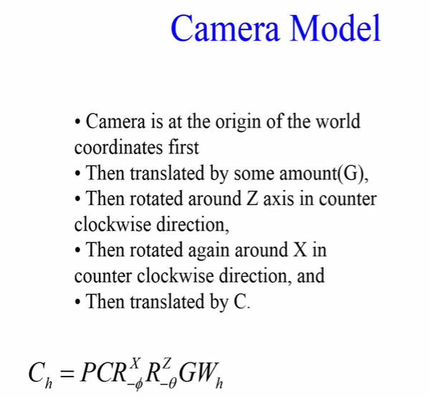

Slide 23
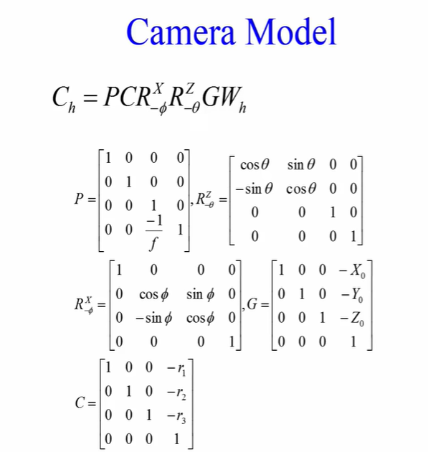

Slide 24
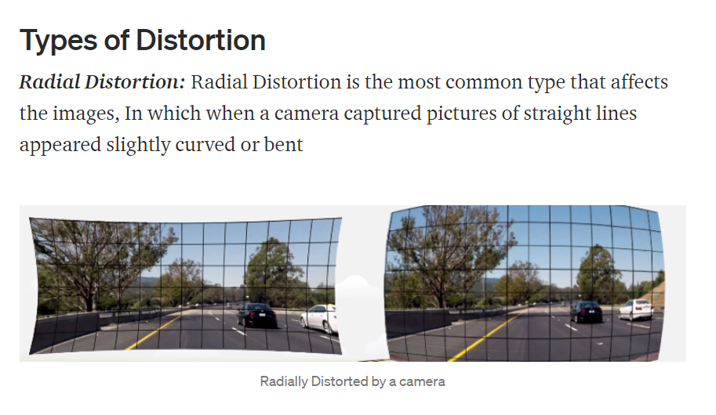

Slide 25
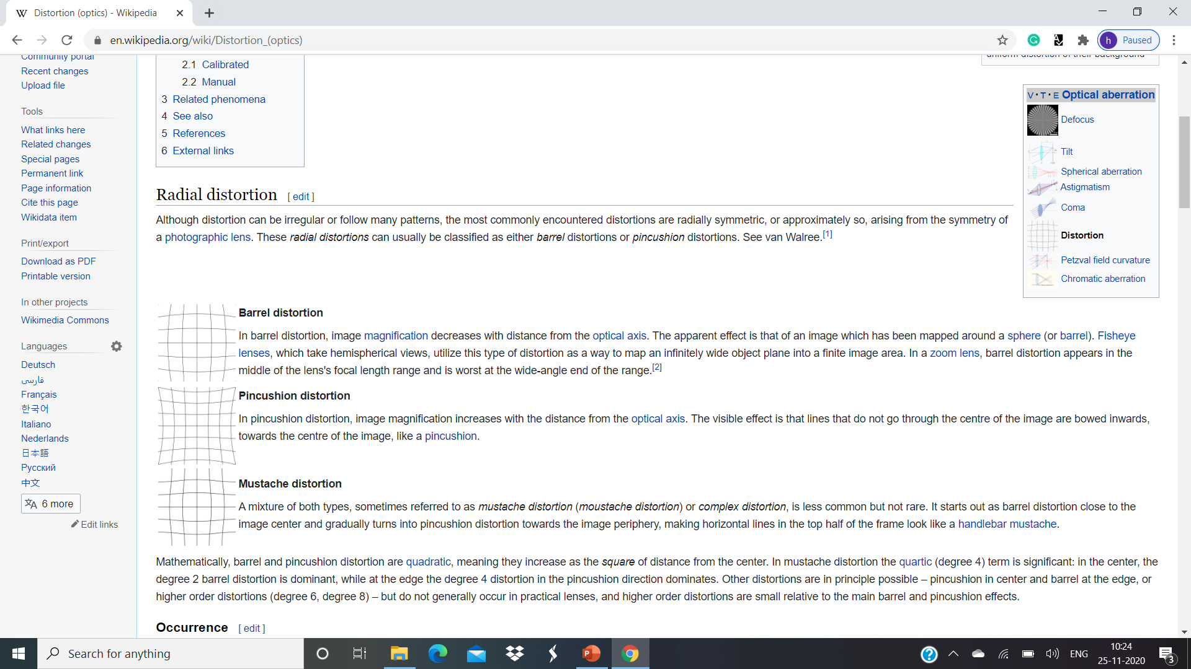
Types of Distortion

Slide 26
Radial Distortion
The radial distortion coefficients model this type of distortion. The distorted points are denoted as (x_{distorted}, y_{distorted}):
x_{distorted} = x(1 + k₁*r² + k₂*r⁴ + k₃*r⁶)
y_{distorted}= y(1 + k₁*r² + k₂*r⁴ + k₃*r⁶)
x, y — Undistorted pixel locations. x and y are in normalized image coordinates. Normalized image coordinates are calculated from pixel coordinates by translating to the optical center and dividing by the focal length in pixels. Thus, x and y are dimensionless.
k₁, k₂, and k₃ — Radial distortion coefficients of the lens.
r²: x² + y²
Typically, two coefficients are sufficient for calibration. For severe distortion, such as in wide-angle lenses, you can select 3 coefficients to include k₃.

Slide 27
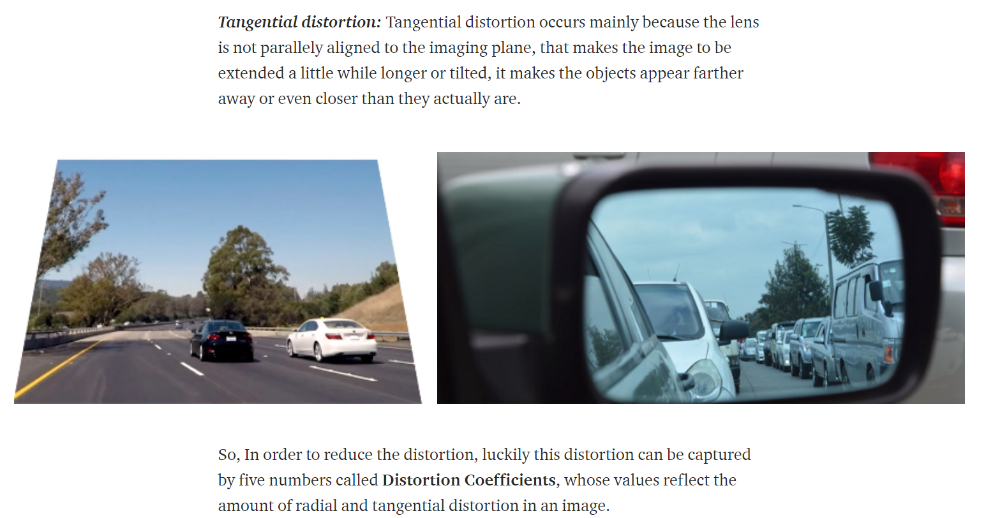

Slide 28
Tangential Distortion
The distorted points are denoted as (x_{distorted}, y_{distorted}):
x_{distorted} = x + [2 * p₁ * x * y + p₂ * (r² + 2 * x²)]
y_{distorted} = y + [p₁ * (r² + 2 *y²) + 2 * p₂ * x * y]
x, y — Undistorted pixel locations. x and y are in normalized image coordinates. Normalized image coordinates are calculated from pixel coordinates by translating to the optical center and dividing by the focal length in pixels. Thus, x and y are dimensionless.
p₁ and p₂ — Tangential distortion coefficients of the lens.
r²: x² + y²

Slide 29
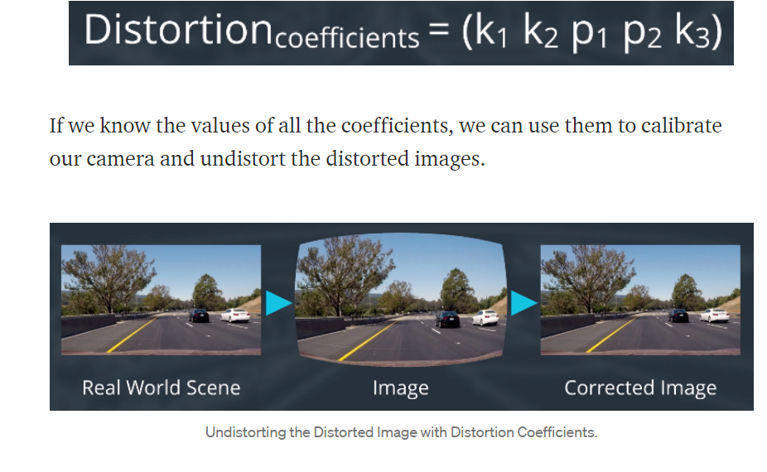

Slide 30
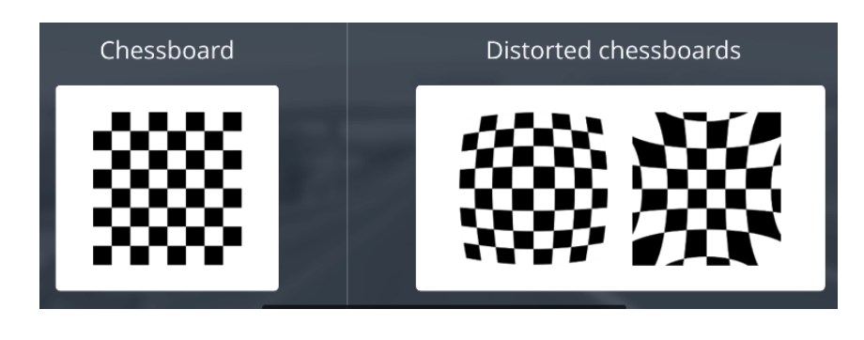
Measuring Distortion

Slide 31
findChessboardCorners()
Parameters
image | Source chessboard view. It must be an 8-bit grayscale or color image.
patternSize | Number of inner corners per a chessboard row and column ( patternSize = cvSize(points_per_row,points_per_colum) = cvSize(columns,rows) ).
corners | Output array of detected corners.
flags | Various operation flags that can be zero or a combination of the following values:
CALIB_CB_ADAPTIVE_THRESH Use adaptive thresholding to convert the image to black and white, rather than a fixed threshold level (computed from the average image brightness).
CALIB_CB_NORMALIZE_IMAGE Normalize the image gamma with equalize Hist before applying fixed or adaptive thresholding.
CALIB_CB_FILTER_QUADS Use additional criteria (like contour area, perimeter, square-like shape) to filter out false quads extracted at the contour retrieval stage.
CALIB_CB_FAST_CHECK Run a fast check on the image that looks for chessboard corners, and shortcut the call if none is found. This can drastically speed up the call in the degenerate condition when no chessboard is observed.

Slide 32
cornerSubPix()
corners=cv.cornerSubPix (image, corners, winSize, zeroZone, criteria)
Parameters
image | Input single-channel, 8-bit or float image.
corners | Initial coordinates of the input corners and refined coordinates provided for output.
winSize | Half of the side length of the search window. For example, if winSize=Size(5,5) , then a (5∗2+1)×(5∗2+1)=11×11 search window is used.
zeroZone | Half of the size of the dead region in the middle of the search zone over which the summation in the formula below is not done. It is used sometimes to avoid possible singularities of the autocorrelation matrix. The value of (-1,-1) indicates that there is no such a size.
criteria | Criteria for termination of the iterative process of corner refinement. That is, the process of corner position refinement stops either after criteria.maxCount iterations or when the corner position moves by less than criteria.epsilon on some iteration.

Slide 33
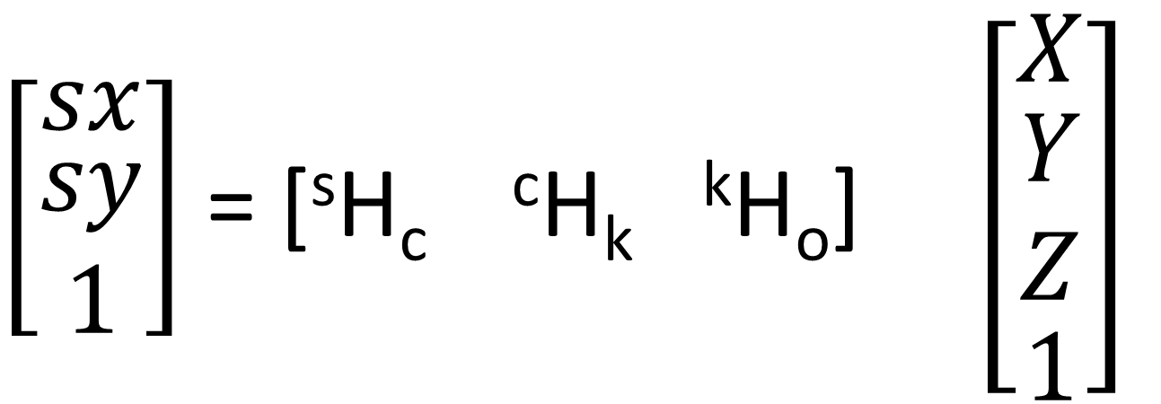
Transformation
$\left[\begin{matrix}sx \\ \begin{matrix}sy \\ 1\end{matrix}\end{matrix}\right]$ = [^{s}H_{c} ^{c}H_{k} ^{k}H_{o}] $\left[\begin{matrix}X \\ \begin{matrix}\begin{matrix}Y \\ Z\end{matrix} \\ 1\end{matrix}\end{matrix}\right]$
Image to sensor
Camera to Image
Object to Camera
In the sensor Systems
In the Object System

Slide 34
